Slide 1
Inventor iLogic Samples Useful Rules For PDM
Markus Koechl
Solutions Engineer PDM|PLM – Autodesk Central Europe

Slide 2
iLogic PDM | Content - Overview
Collection of Rule Samples
Save Meta Data in iProperties for
Parts, Sheet Metal Parts
Assemblies, Weldments
Drawings
Snippet¹ Library
Notes:
1) „Snippets“ are pre-defined pieces of code for fast and convenient re-use. Double-click to insert into code editor window.

Slide 3



iLogic PDM | Content
Rules Samples
BOMTypeToProp
Dimensions
PhysProp
ScaleAndSheet
SetMaterialToCustomProp
UidToProp
UpdateCopiedModelProps
Task(s)
Capture BOM type
Capture bounding or cut dimensions
Physical properties
Mass, material, raw material
Sheet size and main scale
Activate material PDM -> CAD
Capture unique ID for sibling detection
Transfer model properties to IDW/DWG

Slide 4
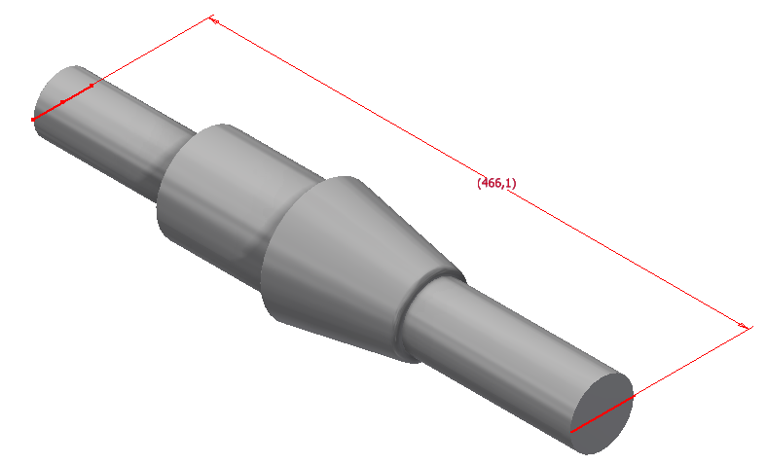
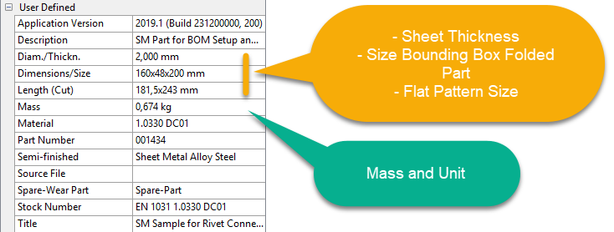
iLogic PDM | Use Case
Rules – Dimensions, PhysProp

Slide 5
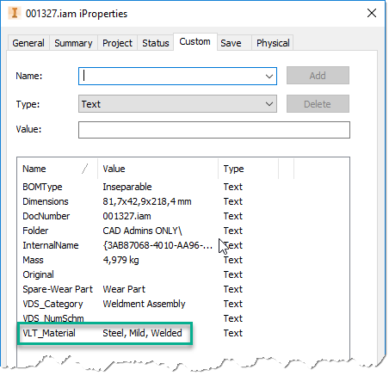
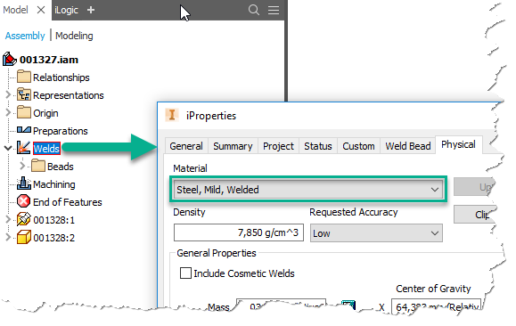
iLogic PDM | Use Case
Weldement – Material of Weld Beads
Rule - PhysProp

Slide 6
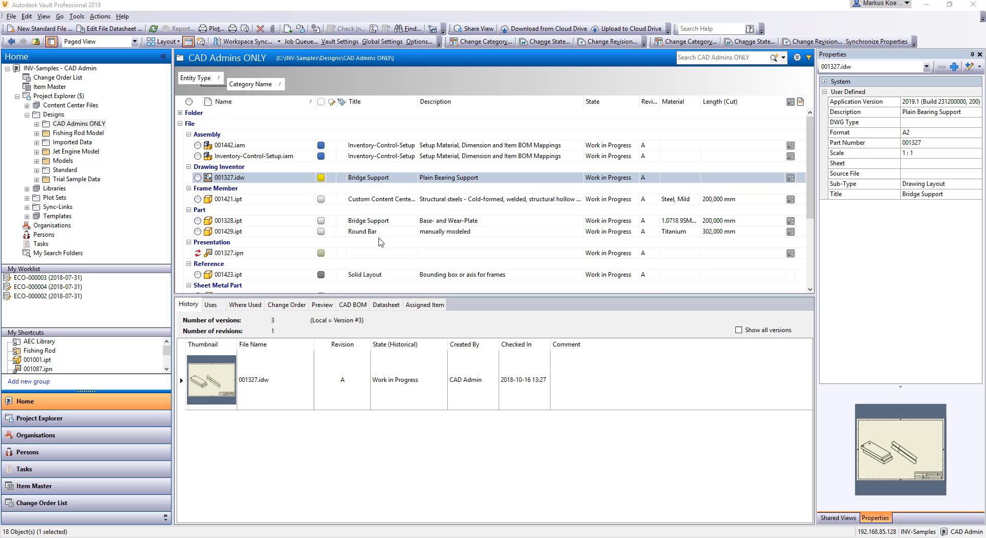
iLogic PDM | Use Case
Rule - SetMaterialToCustomProp

Slide 7
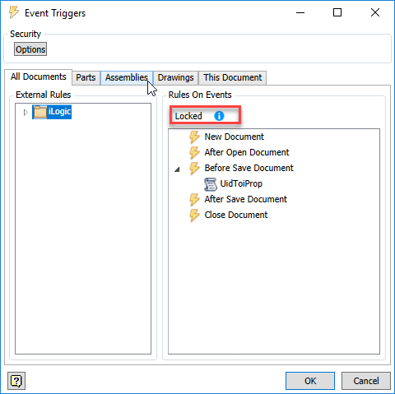
iLogic PDM | Rule Validity
Manage Settings File in Vault
Event Trigger Options
Event Trigger Rules – Document Assignments

Slide 8
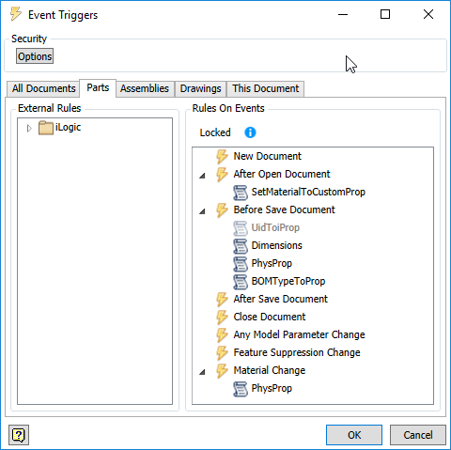
iLogic PDM | Rule Validity - Parts
Differentiation Within Rules For
Part | Sheet Metal Part
Round-, Square-, Profile-Bars
Content Center Files
User Library
ReadOnly Mode

Slide 9
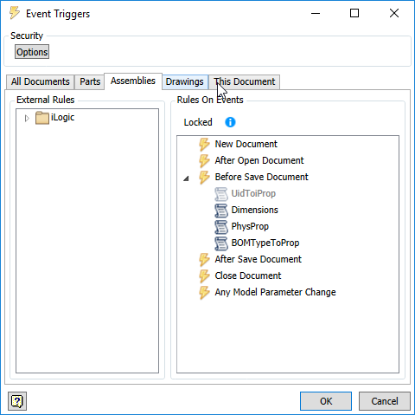
iLogic PDM | Rule Validity - Assemblies
Differentiation Within Rules For
Assembly | Weldment
User Library
ReadOnly Mode

Slide 10
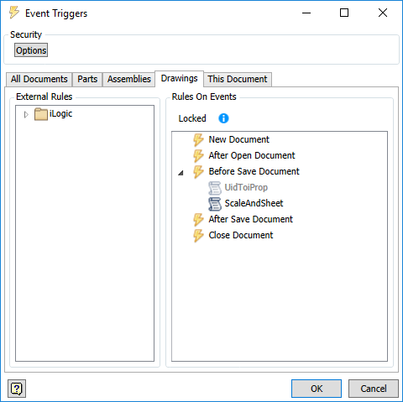
iLogic PDM | Rule Validity – Drawings
Differentiation Within Rules
None

Slide 11
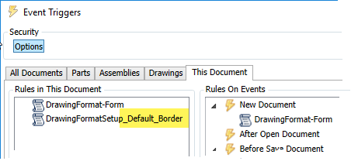
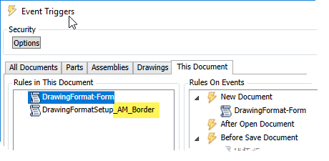
iLogic PDM | Rule Validity – Drawings
Differentiate Within Templates
Dialog, e.g. Language
Drawing Border Type

Slide 12
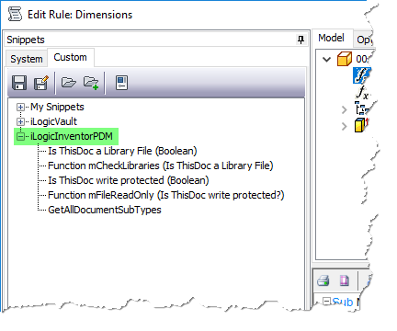
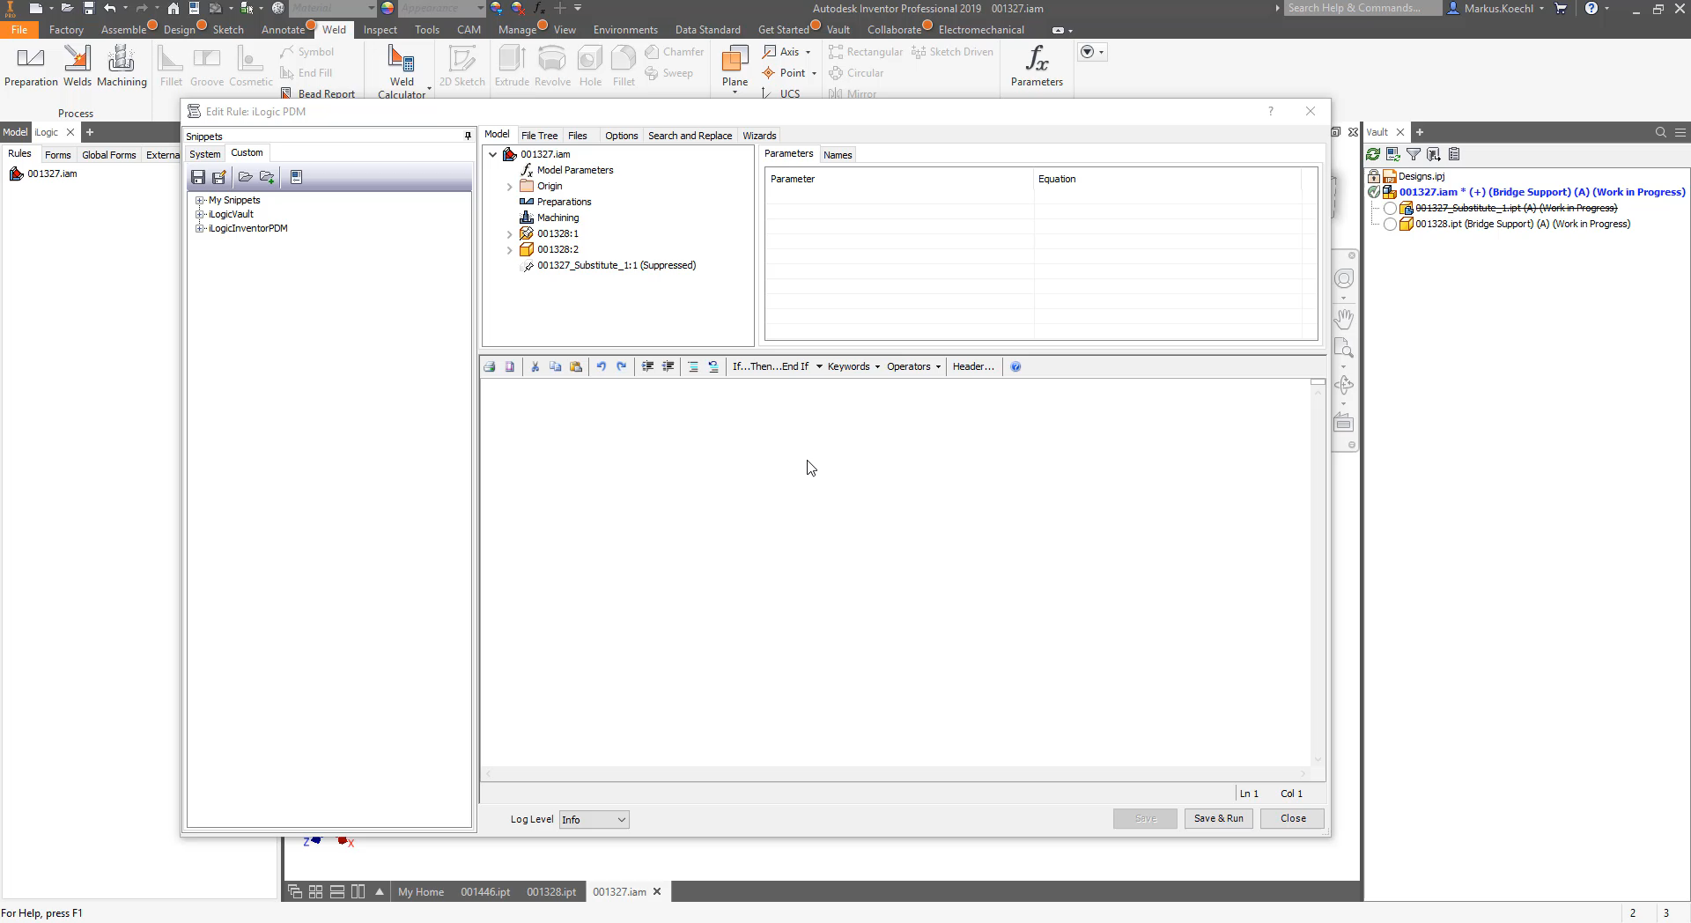
iLogic PDM | Snippets
Methods and Method Calls for „PDM“ Rules

Slide 13
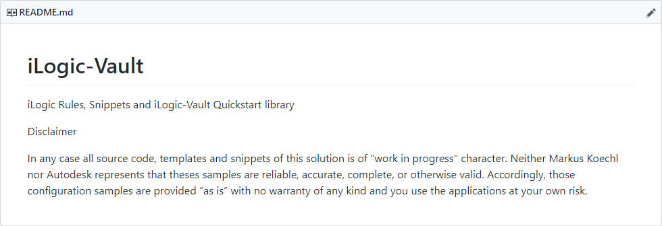
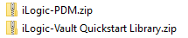
iLogic PDM | Availability
ReadMe
Download

Slide 14
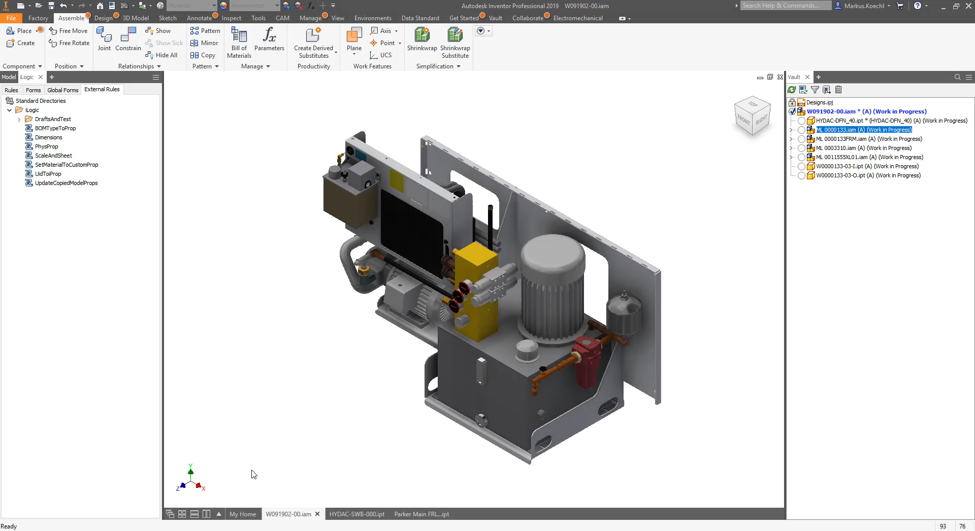
iLogic PDM | Installation

